Slide 1
food services division
COMPETITIVE FOOD & BEVERAGE SALES
Notes:
“THIS IS JUST A PLACE HOLDER FOR SCREEN BEFORE THE PRESENTATION IS READY TO BEGIN”

Slide 2
What Are Competitive Foods?
Competitive Foods is defined as:
All food and beverages other than reimbursable meals available for sale to students on the school campus during the school day.
School campus includes all areas of the property under the jurisdiction of the school that are accessible to students during the school day.
A school day is from midnight to one-half hour after school, Monday through Friday.
Food is considered sold when it is exchanged for money, coupons, vouchers or order forms on the school campus.
Notes:
TELL: The Code of Federal Regulations and the United States Department of Agriculture defines “competitive foods” as; “all food and beverages other than meals reimbursed under programs authorized by the Richard B. Russell National School Lunch Act and the Child Nutrition Act of 1966 available for sale to students on the School campus during the School day.” The School campus is being designated for the purpose of competitive food standards implementation, meaning all areas of the property under the jurisdiction, of the school that are accessible to students during the school day.

Slide 3
Competitive Foods Compliance
All foods/beverages not associated with the meal program MUST meet the competitive food/beverage requirements.
Competitive foods cannot contain trans fat - this applies to ALL foods ( school meals and other)
Notes:
TELL: All food and beverages sold to students on school campus during the school day and outside the meal program MUST meet the competitive food and beverage requirements. This applies to all food and beverages sold to students by any entity. Competitive foods cannot contain trans fat, this applies to ALL foods; such as, school meals and other items.

Slide 4
Competitive Foods Compliance
Competitive foods sold on school campuses have to be evaluated before being sold to students. Lists of approved snacks and beverages can be found on FSD’s webpage:
Principal’s Resources > Competitive Foods
Approved Snacks
Approved Beverages
Notes:
TELL: All food and beverages sold to students on school campus during the school day and outside the meal program MUST meet the competitive food and beverage requirements. This applies to all food and beverages sold to students by any entity. Competitive foods cannot contain trans fat, this applies to ALL foods; such as, school meals and other items.

Slide 5
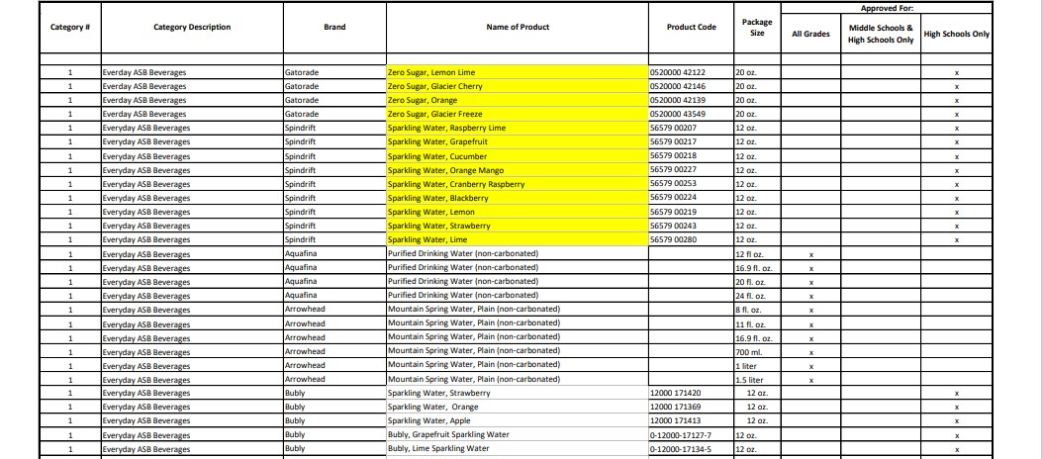
Approved Beverages
Notes:
TELL: All food and beverages sold to students on school campus during the school day and outside the meal program MUST meet the competitive food and beverage requirements. This applies to all food and beverages sold to students by any entity. Competitive foods cannot contain trans fat, this applies to ALL foods; such as, school meals and other items.

Slide 6
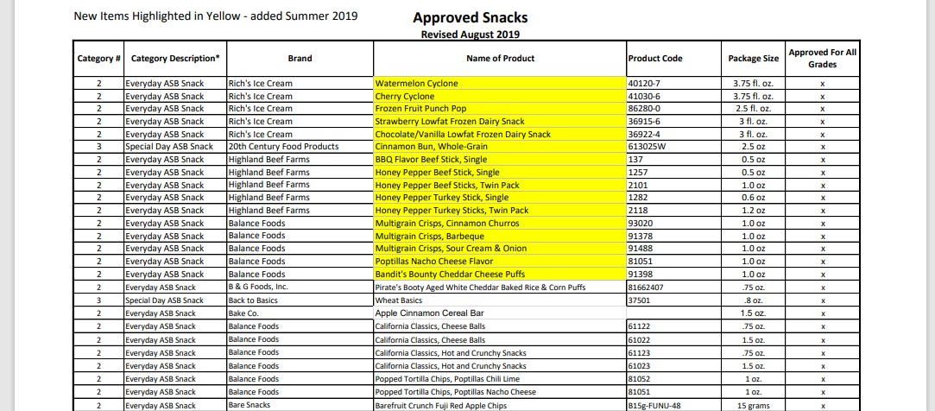
Approved Snacks
Notes:
TELL: All food and beverages sold to students on school campus during the school day and outside the meal program MUST meet the competitive food and beverage requirements. This applies to all food and beverages sold to students by any entity. Competitive foods cannot contain trans fat, this applies to ALL foods; such as, school meals and other items.

Slide 7
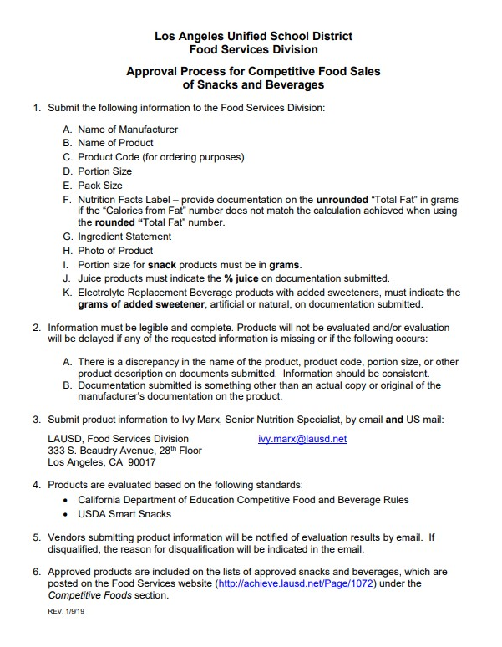
Competitive Foods Approval Process
Foods that are not on the approved snack and beverages lists must go through an approval process.
Submit product information to:
Ivy Marx, Senior Nutrition Specialist
LAUSD, Food Services Division ivy.marx@lausd.net
Notes:
TELL: All food and beverages sold to students on school campus during the school day and outside the meal program MUST meet the competitive food and beverage requirements. This applies to all food and beverages sold to students by any entity. Competitive foods cannot contain trans fat, this applies to ALL foods; such as, school meals and other items.

Slide 8
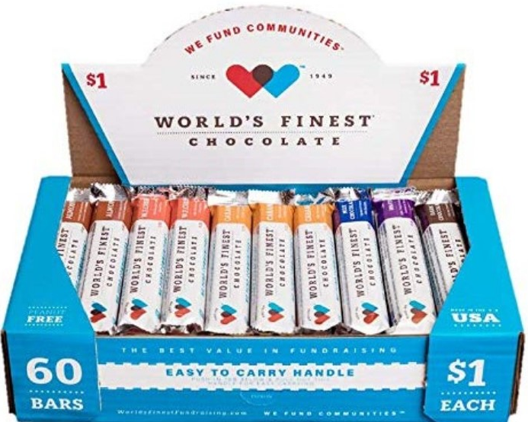
Examples Of Competitive Foods
Notes:
TELL: Now let’s go over a few competitive food and sales terms. The School Day or Effective Period is from Midnight to one-half hour after school.
The definition of sold is the exchange of food for money, coupons, vouchers, or order forms, when any part of the exchange occurs on a school campus.

Slide 9
Competitive Foods Regulations
There are specific State and Federal rules that govern competitive foods and beverages. LAUSD’s Nutrition Policy further restricts the food and beverage items that can be sold.
School Districts shall post the nutrition and physical activity policies, in public view within all school cafeterias or other central eating areas
Notes:
TELL: There are specific State and Federal rules that govern competitive foods and beverages. In addition, LAUSD has a Nutrition Policy that further restricts the allowances of food and beverage items. School Districts shall post the school district’s nutrition and physical activity policies, in public view within all school cafeterias or other central eating areas.

Slide 10
Elementary School Student Organizations
To be compliant you must meet all the following:
Only one food or beverage item per sale
The food or beverage item must be pre-approved by the governing board of the School District
The sale must be after the lunch Period has ended
The food or beverage item cannot be prepared on campus
Each school is allowed four sales per year
The food or beverage item cannot be the same item sold in the food service program at that school during the same school day
Notes:
TELL: In order for elementary schools to be in compliance, they must meet the following: only one food or beverage item per sale. The food or beverage item must be pre-approved by the governing board of the School District. The sale must be after the lunch Period has ended. Also, The food or beverage item cannot be prepared on campus. Each school is allowed four sales per year. Lastly, the food or beverage item cannot be the same item sold in the food services program, during the same school day.

Slide 11
Secondary School Student Organizations
To be compliant, food and beverage sales by student organizations must meet the following:
May sell up to three categories of foods or beverages each day ( e.g. chips, sandwiches, juices, etc.)
The food and beverage categories sold cannot be the same as the categories sold in the food service program at the school during the same school day.
Only one (1) student organization is allowed to sell each day
Notes:
TELL: To be in compliance, food and beverage sales by student organizations must meet the following: they may sell up to three categories of foods or beverages each day ( e.g. chips, sandwiches, juices, etc.). The food and beverage categories sold cannot be the same as the categories sold in the food service program, during the same school day.

Slide 12
Secondary Student Organizations cont.
To be compliant, food and beverage sales by student organizations must meet the following:
In addition to one student organization sale each day, any and all student organizations may sell on the same four (4) designated days per year
School Administration may set these dates
The food or Beverage items cannot be prepared on campus
Notes:
TELL: Continuing on from the previous slide, secondary schools refer to the Quick reference Card ( QRC) which summarizes the restrictions of food and beverage allowances. Remember only one (1) student organization is allowed to sell each day. In addition, to one student organization sale each day, any and all student organizations may sell on the same four designated days per year. The school administration may set these dates and food or beverage items cannot be prepared on campus.

Slide 13
Quick Reference Cards
The Quick Reference Cards (QRC) summarizes the restrictions of food and beverage allowances.
The QRC can be found on FSD’s website:
Principal’s Resources > Competitive Foods
LAUSD BUL-6292.1 Guidelines for Sales and Service of Non-School Meal Program Food/Beverages on School Campus
Notes:
TELL: Continuing on from the previous slide, secondary schools refer to the Quick reference Card ( QRC) which summarizes the restrictions of food and beverage allowances. Remember only one (1) student organization is allowed to sell each day. In addition, to one student organization sale each day, any and all student organizations may sell on the same four designated days per year. The school administration may set these dates and food or beverage items cannot be prepared on campus.

Slide 14
PTA, PTO and Other Organizations
PTA’s and PTO’s can fundraise/sell on-campus during the school day.
District policies on their fundraisers/sales must be followed.
Fundraising should be conducted through the Associated Student Body and its established clubs.
Can sale compliant items that the meal program is also selling.
Athletic Department, individual teachers, and classrooms are not legally authorized to fundraise at any time.
Notes:
TELL: The PTA and other organizations under Education Code 51520 allow parent/ teacher association and parent/teacher organization to fundraise and sell on-campus during the school day.
District policies on their fundraisers/sales must be followed. The Athletic Department, teachers, and classrooms are not legally authorized to fundraise at any time.
Fundraising should be conducted through the ASB and its established clubs.
The State Rule allows the PTA/PTO to organize a sale of compliant items on campus during the school day. The program can also sell the same item that the meal program is selling.

Slide 15
Fundraising Options
Food sales aren’t the only way to raise money in school. Non-Food Alternatives is a list of ideas to raise money that do not involve food.
Available on FSD’s webpage:
Principal’s Resources > Competitive Foods
Fundraising and Student Rewards Ideas
Notes:
TELL: The PTA and other organizations under Education Code 51520 allow parent/ teacher association and parent/teacher organization to fundraise and sell on-campus during the school day.
District policies on their fundraisers/sales must be followed. The Athletic Department, teachers, and classrooms are not legally authorized to fundraise at any time.
Fundraising should be conducted through the ASB and its established clubs.
The State Rule allows the PTA/PTO to organize a sale of compliant items on campus during the school day. The program can also sell the same item that the meal program is selling.

Slide 16
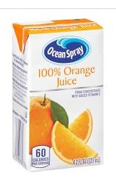
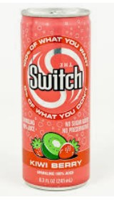
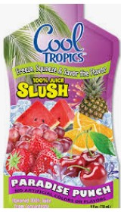
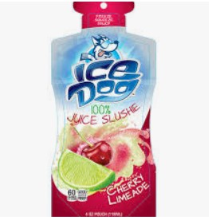
Compliant Beverage
If a beverage contains a blend of beverages that would all otherwise be compliant, then the mixed beverage is considered compliant.
For example, if a beverage contains a mix of fruit and vegetable juices, and the fruit juice and vegetable juice would be compliant by themselves, then the mixed beverage is compliant.
Notes:
TELL: Let’s take a look at a compliant beverage. If a beverage contains a blend of beverages that would all otherwise be compliant, then the mixed beverage is considered compliant.
For example, if a beverage contains a mix of fruit and vegetable juices, and the fruit juice and vegetable juice would be compliant by themselves, then the mixed beverage is compliant.

Slide 17
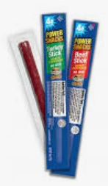
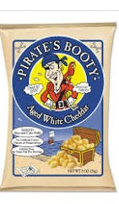
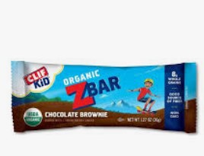
COMPLIANT FOODS FOR ELEMENTARY SCHOOLS
Must meet one of the following parameters:
Fruit
Non-fried vegetable
Dairy food
Nuts, seeds, Legumes, Eggs, Cheese
Whole grain item
Notes:
TELL: : Now let’s discuss compliant foods for elementary schools. Must meet one of the following criteria, Fruit, Non-fried vegetable, Dairy food, Nuts, seeds, Legumes, Eggs, Cheese and
Whole grain items.

Slide 18
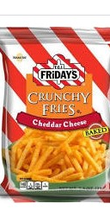
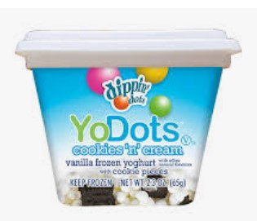
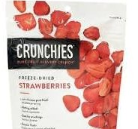
Compliant Foods For Secondary Schools
Must meet one of the following parameters:
Fruit
vegetable
Dairy, protein, or whole grain item, (have one of this as the first ingredient)
Contain 10 percent DV for calcium, potassium, vitamin D or dietary fiber.
Notes:
TELL: Continuing on from the previous slide let’s discuss compliant foods for middle/high schools that must meet one of the following criteria; Fruit, Vegetable, Dairy, protein, or whole grain item, ( have one of this as the first ingredient)
And contain 10 percent Daily Value for calcium, potassium, vitamin D or dietary fiber.

Slide 19
QUESTIONS ?
Notes:
TELL: Thank you for attending the Competitive Food and Beverage Sales training. Any questions?

